Slide 1
Complex Sensor Data Handling & Fusion

Slide 2

Agenda
01
Advanced Sensor Tech in ADAS
02
Handling Complex Sensor Data
03
Principles for Sensor Fusion & Implementation

Slide 3

01 – Advanced Sensor Tech in ADAS

Slide 4
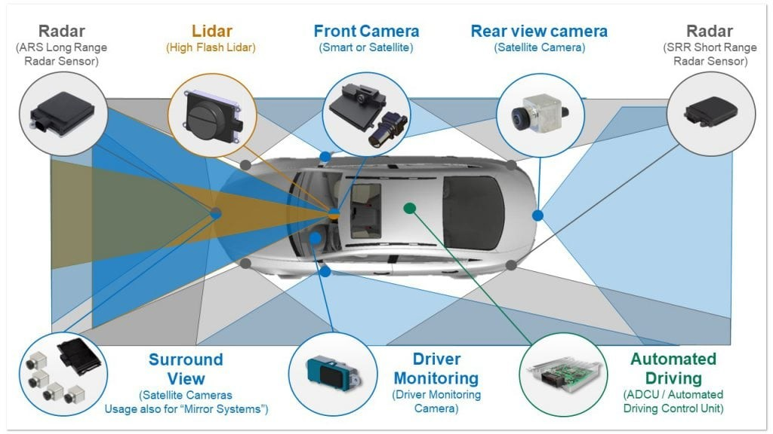
Advanced Sensor Tech in ADAS
Sensors on a Car
Overview
Definition: Sensors act as the car's "eyes and ears," collecting data on the environment to enable various ADAS functionalities.
Importance: these play a critical role in ADAS to improve performance & safety
Enhancing Perception
Enabling Automation
Improving Safety
Notes:
Enhancing Situational Awareness: Sensors provide a 360-degree view around the vehicle, allowing ADAS systems to detect and track objects, pedestrians, and lane markings more effectively than human drivers can alone.
Improving Response Time: By constantly monitoring the environment, sensors enable ADAS systems to react to potential hazards much faster than humans, leading to shorter stopping distances and reduced collision risks.
Enabling Advanced Features: Advanced sensors like LiDAR are crucial for the development of more sophisticated ADAS features, paving the way for partially and fully autonomous vehicles.
Notes:
Traditional ADAS sensors include cameras, radar, and ultrasonic sensors. Each has its strengths and weaknesses:
Cameras offer high resolution for object and lane recognition but struggle in low-light conditions.
Radar excels in all weather conditions but has lower resolution for detailed object classification.
Ultrasonic sensors are good for short-range object detection for parking assistance but have a limited field of view.
Newer, advanced sensor technologies are emerging to address these limitations:
LiDAR (Light Detection and Ranging) creates high-resolution 3D maps of the surroundings using pulsed laser light, offering superior object detection and distance measurement in all weather conditions.
Thermal cameras can detect heat signatures, making them ideal for identifying pedestrians and animals in low-light scenarios.
Discussion Points:
How can sensor fusion, combining data from multiple sensors, improve the reliability and accuracy of ADAS features?
What are the challenges of integrating advanced sensors like LiDAR into production vehicles at scale?
How will future sensor technologies contribute to the development of fully autonomous driving?
References:
Role of Sensors and Actuators in ADAS
ADAS sensors (Advanced Driver Assistance Systems)

Slide 5
02 – Handling Complex Sensor Data

Slide 6
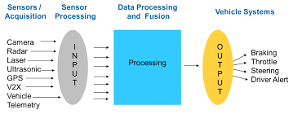
Handling Complex Sensor Data
Sensor Data Process
Overview
Definition: Information collected from various advanced sensors can be high-resolution, multi-dimensional, and require real-time processing for optimal ADAS performance.
Importance: Enhances the processes of sensor information for ADAS features critical to operations
Safety & Reliability
Reduce Latency
Improved Efficiency
Notes:
Safety and Reliability: Accurate and timely processing of sensor data ensures ADAS features function correctly and can react appropriately to critical situations.
Reduced Latency: Minimizing delays in data processing allows for faster response times from ADAS systems, leading to safer driving experiences.
Improved Efficiency: Extracting relevant information from sensor data optimizes resource allocation within the AAOS platform.
Notes:
AAOS offers various techniques for handling complex sensor data:
Sensor Abstraction Layer (HAL): The HAL acts as a middle layer between the physical sensors and the AAOS framework. It provides a standardized interface for accessing and controlling sensor data, simplifying application development.
Sensor Data Fusion: AAOS facilitates the fusion of data from multiple sensors, like cameras, radar, and LiDAR. By combining information from different sources, the system gains a richer understanding of the environment, enhancing accuracy and reliability.
Data Filtering and Preprocessing: Techniques like filtering and noise reduction are employed to remove irrelevant information and ensure the quality of sensor data before feeding it to ADAS features.
Sensor Data Management: AAOS provides tools for managing the high volume of sensor data efficiently. This includes techniques for data buffering, prioritization, and storage optimization.
Additional Notes:
Security is a paramount concern when handling sensor data in AAOS. Measures are implemented to ensure data privacy and prevent unauthorized access.
Discussion Points:
How can sensor data quality be maintained throughout the processing pipeline within AAOS?
What are the trade-offs between processing sensor data on-device versus leveraging cloud-based processing power?
How can AAOS be further optimized to handle the ever-increasing complexity of sensor data generated by future ADAS advancements?
References:
Android Automotive OS HAL: https://source.android.com/docs/automotive
Sensor Fusion for ADAS: https://dl.acm.org/doi/abs/10.1016/j.sysarc.2023.102932

Slide 7
03 – Principles for Sensor Fusion & Implementation

Slide 8
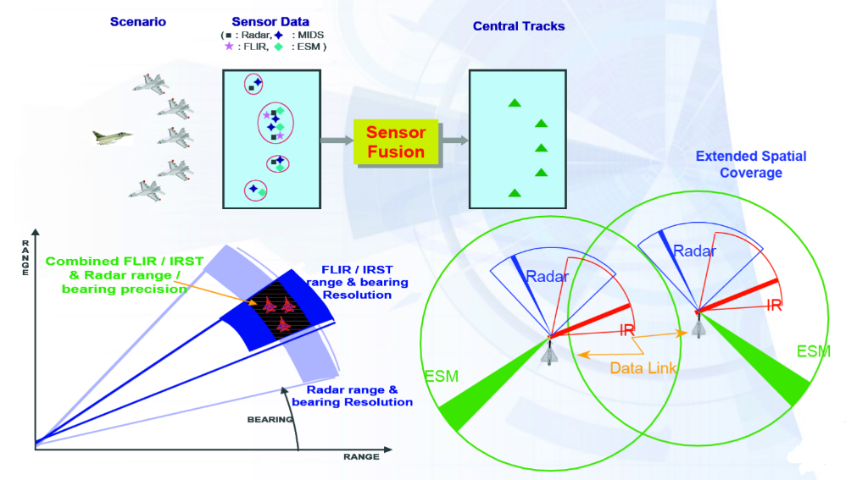
Principles for Sensor Fusion & Implementation
Sensor Data Analysis
Overview
Definition: process of combining data from multiple sensors to create a more comprehensive and accurate picture of the surrounding environment
Importance: plays a critical role in overcoming the limitations of individual sensors & enabling robust ADAS features
Enhanced Accuracy & Reliability
Improved Situational Awareness
Enabling Advanced Features
Notes:
Enhanced Accuracy and Reliability: By combining data from various sources with different strengths and weaknesses, sensor fusion overcomes individual sensor limitations and reduces overall uncertainty in the perceived environment.
Improved Situational Awareness: Fused sensor data provides a richer and more detailed understanding of the surroundings compared to relying on a single sensor type. This leads to more informed decision-making for ADAS functionalities.
Enabling Advanced Features: Sensor fusion unlocks the potential for more sophisticated ADAS features requiring comprehensive environmental data analysis, like object classification in complex scenarios or highly precise lane positioning.
Principles of Sensor Fusion:
Data Association: This crucial step establishes which data points from different sensors correspond to the same real-world object or event. Techniques like nearest neighbor matching and Kalman filtering are used for association.
State Estimation: Sensor fusion employs state estimation algorithms to infer the dynamic state (position, velocity, etc.) of objects in the environment based on the combined sensor data. The Kalman filter is a prominent example.
Sensor Complimentarity: The principle leverages the strengths of different sensors to compensate for each other's weaknesses. For instance, LiDAR offers high-resolution 3D data but might struggle with color recognition, while cameras excel at color but have limitations in depth perception.
Implementation in AAOS:
Sensor Abstraction Layer (HAL): The HAL provides a standardized interface for accessing data from various sensors, simplifying the fusion process within the AAOS framework.
Data Fusion Frameworks: AAOS integrates software frameworks specifically designed for sensor fusion tasks. These frameworks handle data synchronization, association, and transformation from different sensors.
User-Space Libraries: Developers can leverage sensor fusion libraries within AAOS to implement custom fusion algorithms tailored to specific ADAS functionalities.
Discussion Points:
How can sensor fusion algorithms be optimized for real-time performance within the resource constraints of the AAOS platform?
What challenges arise in ensuring data consistency and synchronization from various sensors for effective fusion?
How can future AAOS versions be enhanced to further simplify and streamline the development of sensor fusion applications for ADAS?
References:
Sensor Fusion for ADAS: https://dl.acm.org/doi/abs/10.1016/j.sysarc.2023.102932
Android Automotive OS HAL: https://source.android.com/docs/automotive

Slide 9
Thank You!

